Slide 1
C
Culminating
E
Experience
U
Undergraduate
Being an Intrapreneur at the Co-op Employer
and Employer Insight

Slide 2
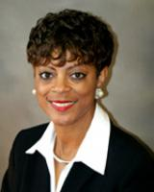
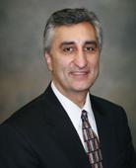
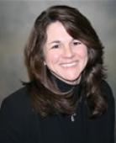
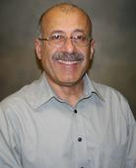
Venetia Petteway
Dr. Massoud Tavakoli
Professor
of Mechanical Engineering
Program Director of Cooperative Education
This week’s Presenters
Dr. Terri Lynch-Caris
Dr. Mohammad Torfeh
Director of CETL & Professor of Industrial Engineering
Professor of Electrical Engineering

Slide 3
Being an Intrapreneur at your Co-op Employer

Slide 4
(1 minute) Activity: List the attributes of a successful Entrepreneur.

Slide 5
Did you mention that an entrepreneur:
Seeks Opportunities
Creates Value
Communicates well to find support, resources and customers

Slide 6
Did any successful entrepreneur ever wait for someone to tell them what opportunity to seek or where to create value?

Slide 7
(1 minute) Activity Within your company, where can you:
Seek Opportunities
Create Value
Communicate to find support, resources and customers

Slide 8
The CUE is an opportunity for you to be an intrapreneur by communicating value-added opportunities with your thesis
Intrapreneurship is the act of behaving like an entrepreneur while working within an organization.

Slide 9
Resources on Campus
INEN Course of Study (get credit for it!)
KES (learn from your peer network and get seed funding)
T-space (tinker your heart out!)
SBDC (learn how to start a business)
Innovation Center (get more serious!)
CCUE (work on industry projects and faculty research topics)

Slide 10
Employer Insight Presented By Venetia Petteway

